Slide 1
Political Revolutions

Slide 2
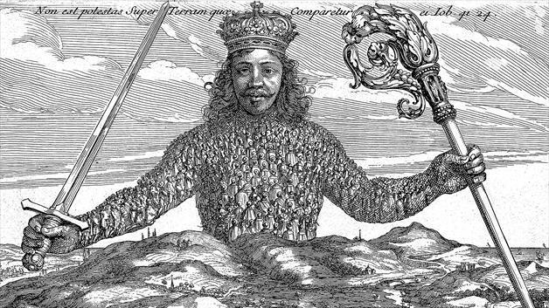
New Definitions of Freedom: Popular (National) Sovereignty
Legitimate authority rests on consent of the governed
“Nations” (ill-defined concept) should have their own states
People (demos) should choose their political representatives

Slide 3
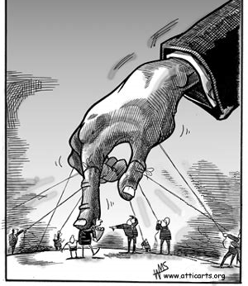
New Definitions of Freedom: Removing the Fetters
Classical economists Adam Smith and David Ricardo developed economic theory of “invisible hand”
Jeremy Bentham and (later) John Stuart Mill developed “utilitarian” philosophy around the principle of unfettered individualism

Slide 4
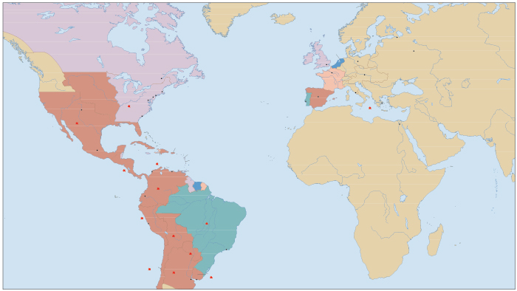
French Revolution, 1789-1799
United States, 1776
Mexico, 1821
Haiti, 1804
Revolutions in the Atlantic System
Brazil, 1822

Slide 5

French Revolution, 1789-1799
United States, 1776
Mexico, 1821
Haiti, 1804
Revolutions in the Atlantic System
Brazil, 1822

Slide 6
Factors Contributing to Atlantic Revolutions, 1770-1820s
Conflicts among the imperial powers
Transnational circulation of Enlightenment ideas
Social stratification in colonial societies

Slide 7
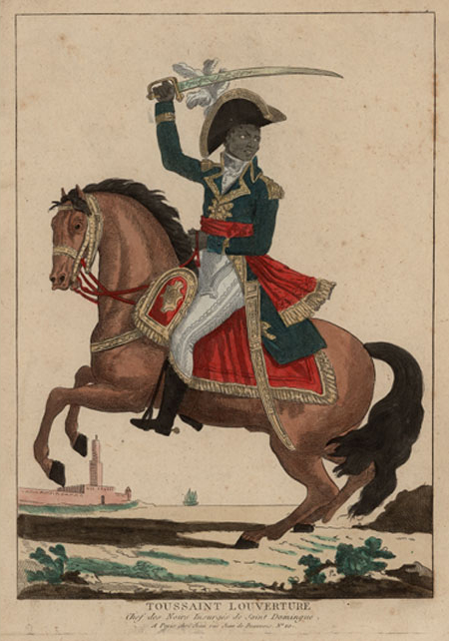
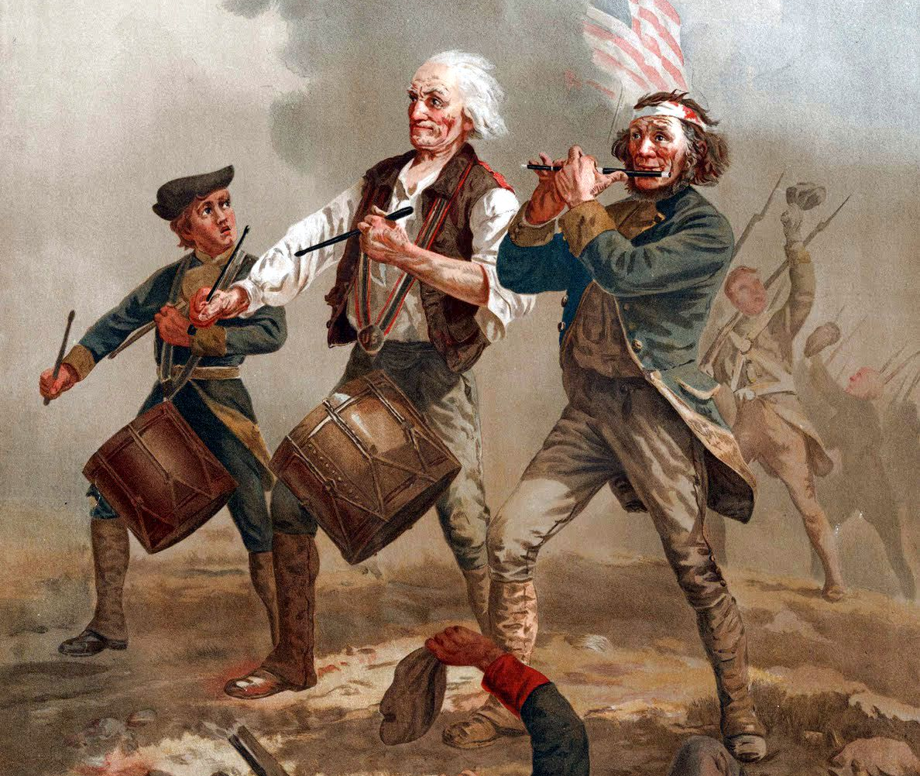
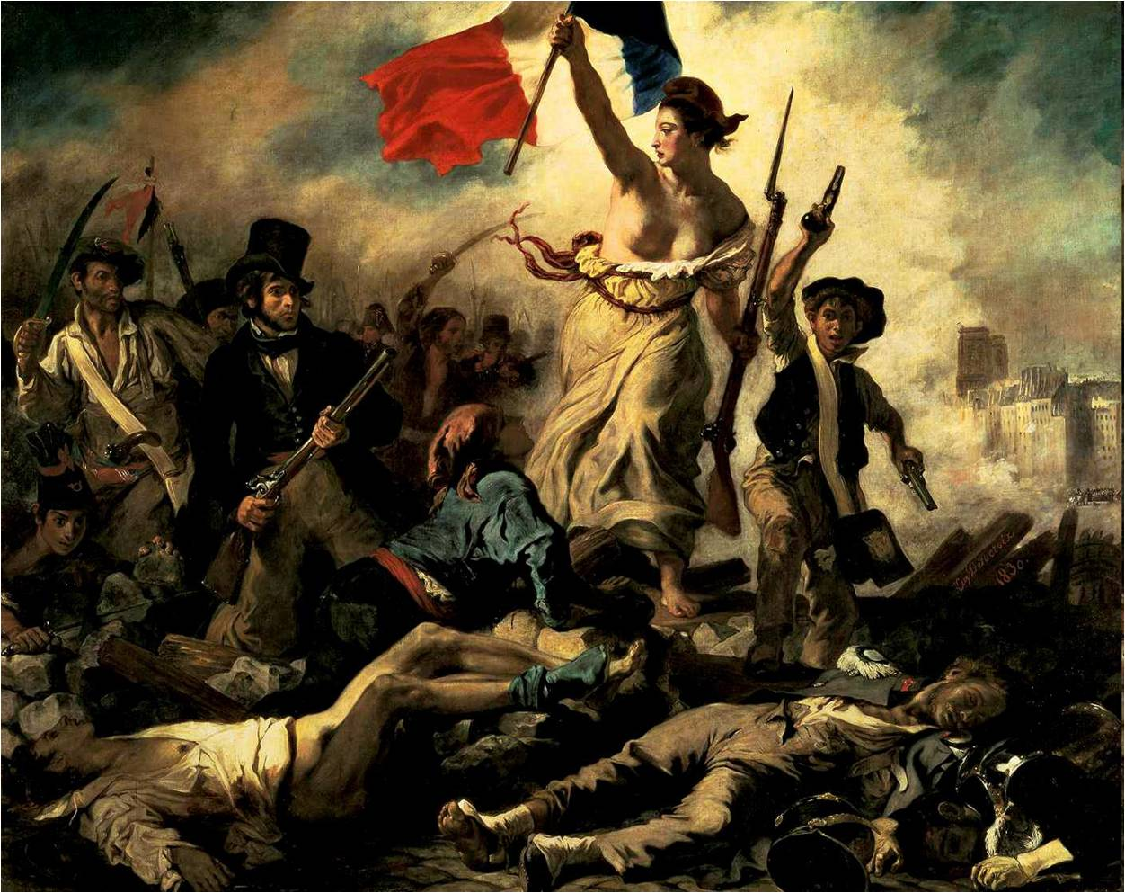
A Tale of Three Revolutions: The Power and Limits of Enlightenment Ideals

Slide 8
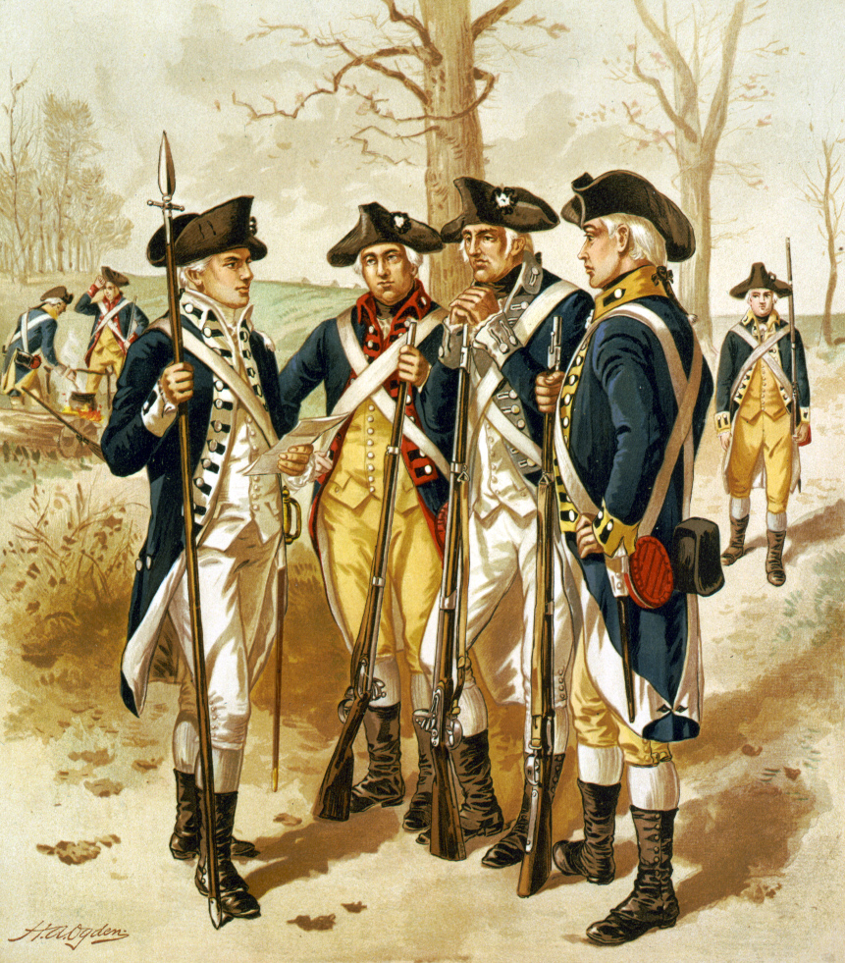
American Revolutionary War
Enlightenment Ideals in the Service of Traditional Elites

Slide 9
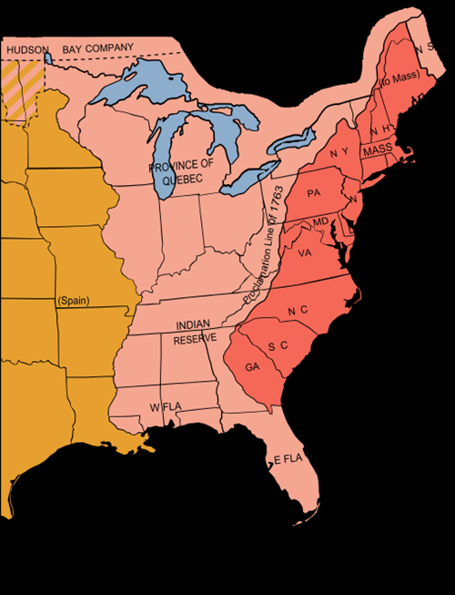
Evolution of British North American Colonies, 1700-1770
250,000 - 2 million
From 1:19 colonist to English ratio to 1:3
9 out 10 English colonists to about 5 out of 10
1 out of 25 African to about 1 out of 5

Slide 10
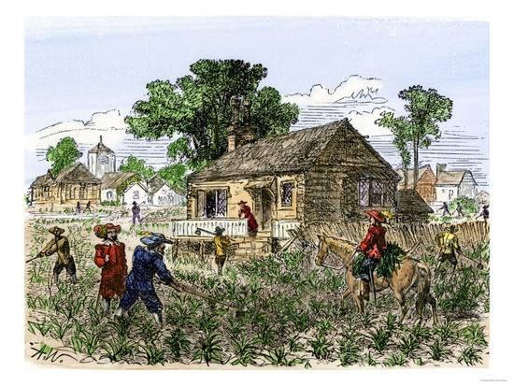
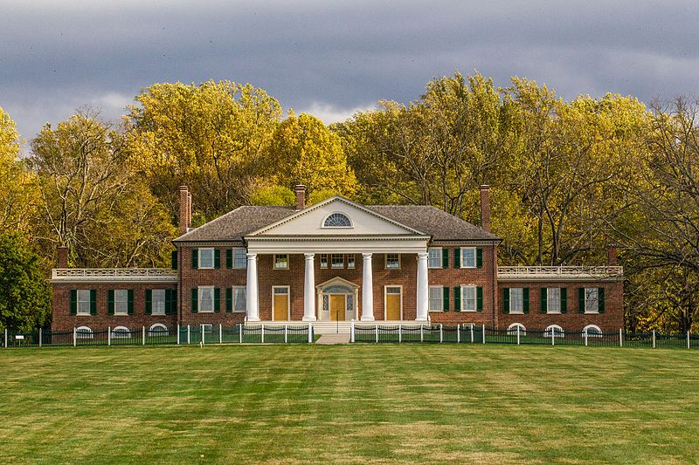
Southern Plantation Economy

Slide 11
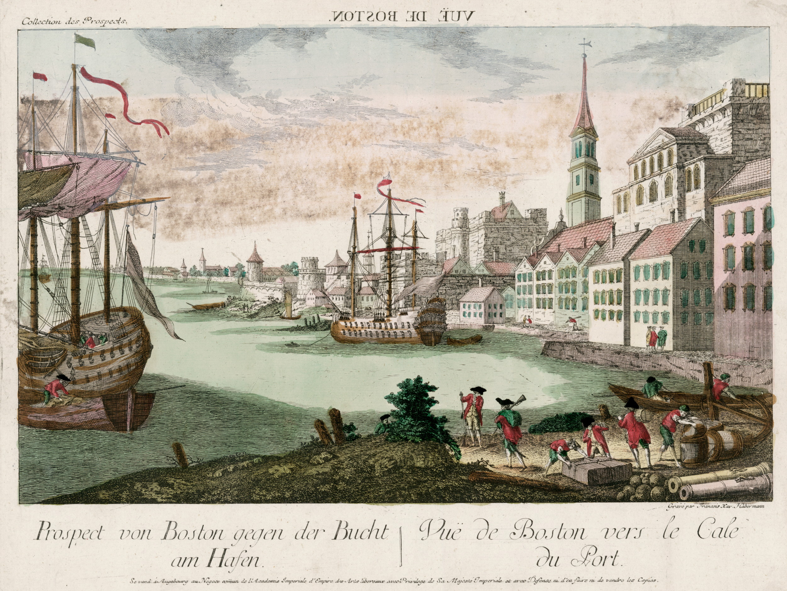
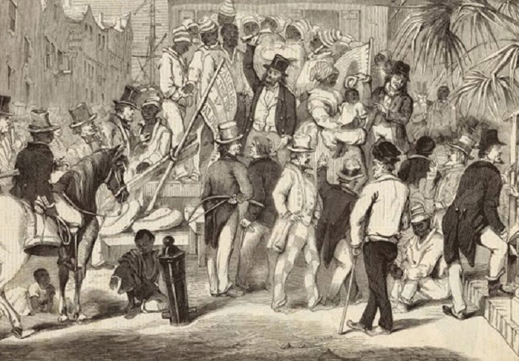
Boston, Philadelphia, New York, Charleston had become thriving port cities

Slide 12
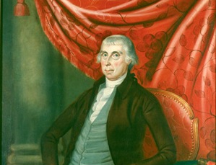
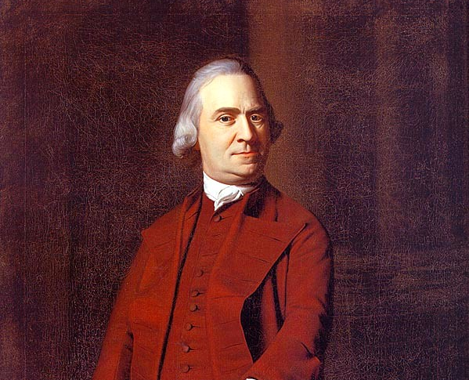
Colonial Elites
Monocrop export anchored economy, richest colony was Virginia, richest families tobacco planters
Northern port cities gave rise to urban economies
Puritan “native” families rose to the top of North American manufacture and administrative economy

Slide 13
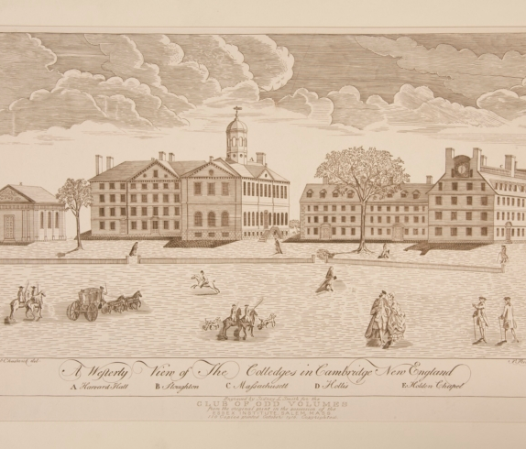
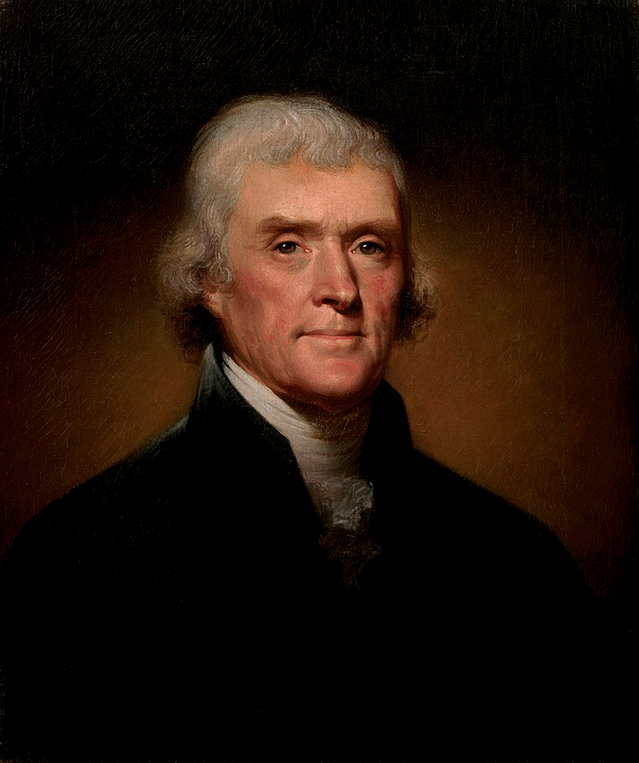
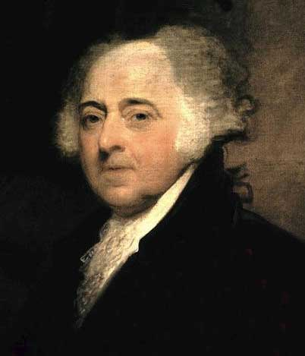
Colonial Education
Colonial colleges such Harvard, Yale, Princeton initially founded to train clergy
Southern elites had private schooling in the classics and Enlightenment philosophers
Harvard under John Leverett and Princeton under John Witherspoon adopted political philosophy curricula
Revolutionary leaders such as John Adams and Thomas Jefferson studied English empiricists

Slide 14
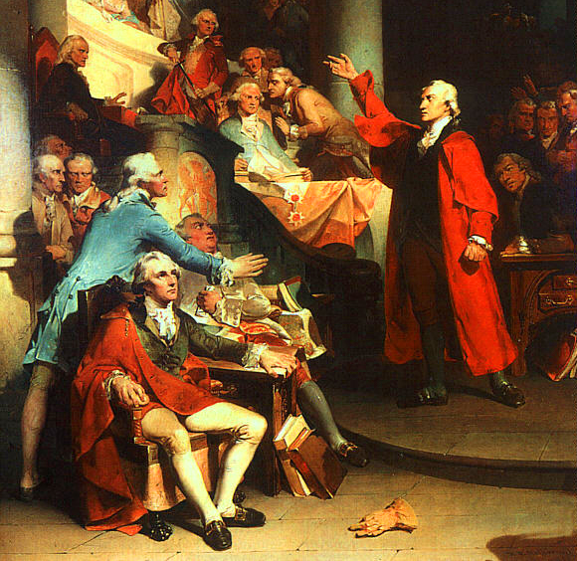
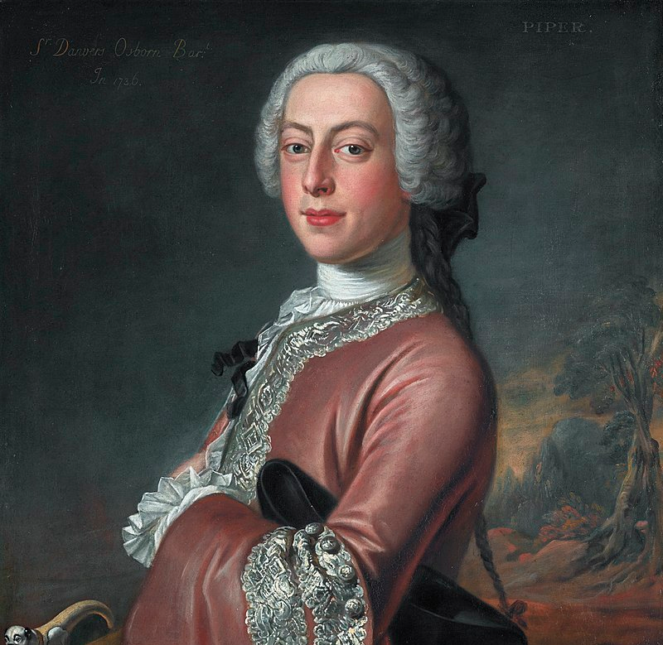
Colonial Administration and Citizenship
Relatively open colonial society
British trade monopoly
Mostly English-born colonial governors, benefitting from aristocratic patronage
Governors clashed with local assemblies, mostly over customs duties
Notes:
Sir Danvers Osborn, 3rd Baronet

Slide 15
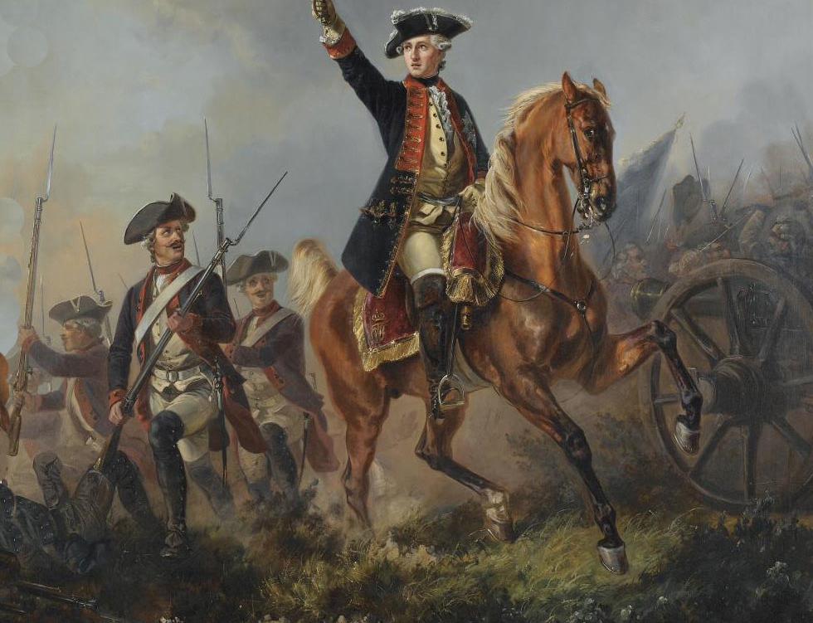
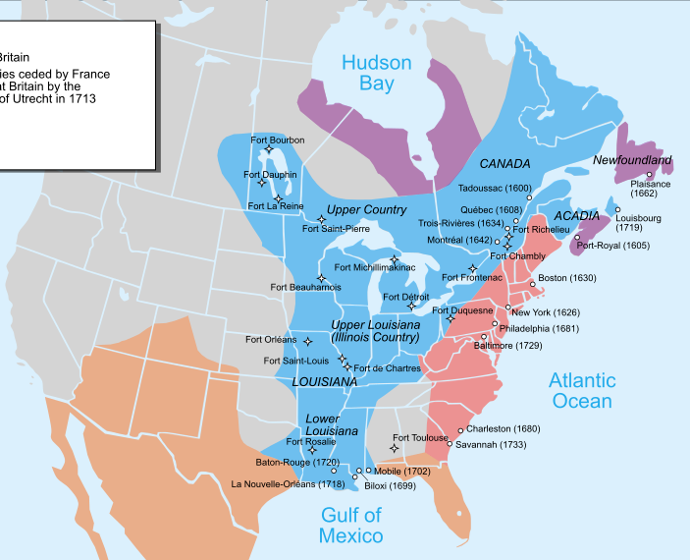
Seven Years’ War
British colonists infringed on French-Indian fur trade
Americans gained experience in British military
After battle of Duquesne British pressed colonists to shoulder costs of the war
Opening knell of a protracted inter-imperial war that was expensive and absorbed the administrative attention of inefficient bureaucracies

Slide 16
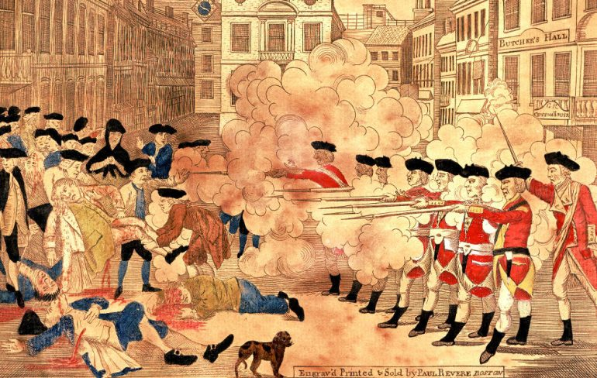
Taxation and Rebellion
King George imposed customs duties to raise revenue for wars with France and Spain
Colonial elites fomented rebellious spirit with rhetoric of liberty, nationalism, and popular sovereignty

Slide 17
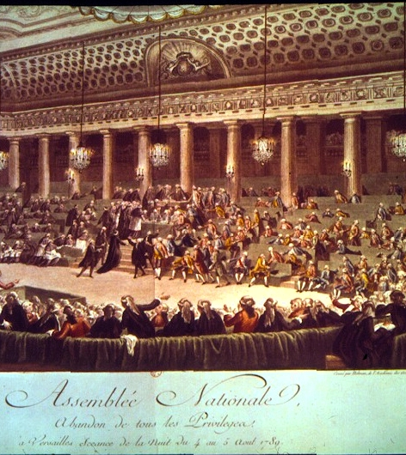
The French Revolution
Social Unrest Infused with Egalitarian Ideals

Slide 18
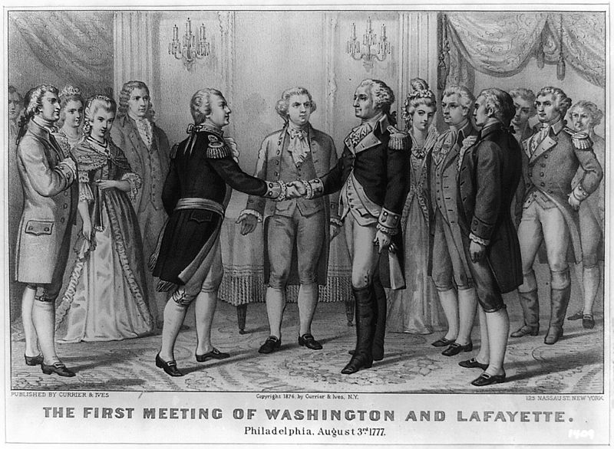
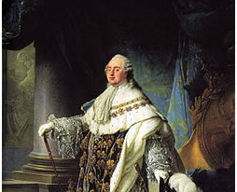
French Involvement In American Revolution
Sore about loss in Seven Years’ War, Louis XVI spent heavily to support rebels
Treaty of Paris restored France as colonial power, further deteriorated relations with Great Britain
1783-1789- financed debt with more debt
Summons Estates General 1789

Slide 19
Timeline of French Revolution
17 June 1789- National Assembly
14 July 1789- Bastille Day
27 August 1789- “Declaration of the Rights of Man and Citizen”
5 October 1789- Women’s March on Versailles
5 September 1791- “Declaration of the Rights of Woman and Citizen”
21 January 1793- Louis XVI Executed
April 1793- Committee of Public Safety Formed
1793-1794- Reign of Terror
27 July 1794- Thermidor
1795-1799- The Directory
9/10 November 1799- 18th Brumaire

Slide 20
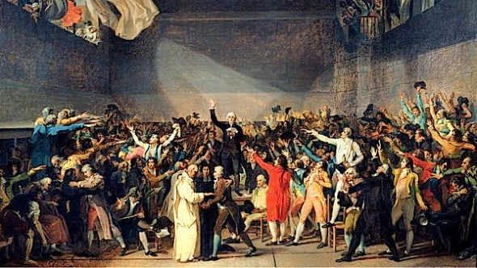
National Assembly
King grudgingly calls Estates-General to raise revenue
Clergy (First Estate) and aristocracy (Second Estate) overruled by the people (Third Estate)
Third Estate declared “National Assembly,” effectively assuming sovereignty
Enter period of “dual power”
Notes:
Emphasize that this entered a period of “dual power.” Unlike American revolution, this was an actual revolution in which power transferred forcibly into the hands of a new class of people within a society or nation.

Slide 21
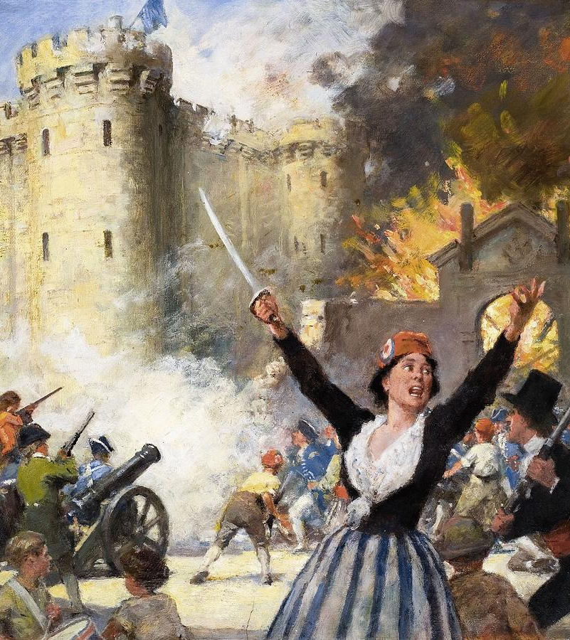
Storming the Bastille:
The First Test of Dual Power
Notes:
July 14, 1789 Parisian crowd seized weapons from a medieval armory, supplied them with artillery, freed prisoners, cut off the head of the commanding officer and paraded it through town. Force against force, with preponderance clearly in the hands of the people

Slide 22
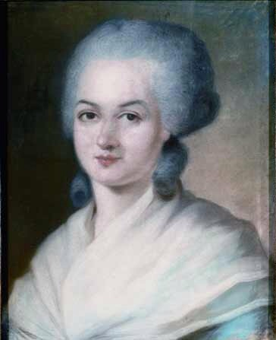
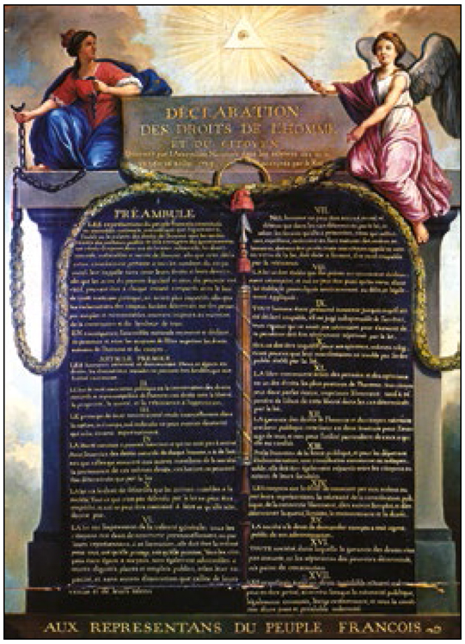
Pushing the Enlightenment Forward
“Declaration of the Rights Man and Citizen,” 1789
“Declaration of the Rights of Woman and the Female Citizen,” 1791
Fused spontaneous mass movement with universalist ideals of the Enlightenment
Most radical moment of the Enlightenment as supported by substantial layers of bourgeois intelligentsia

Slide 23
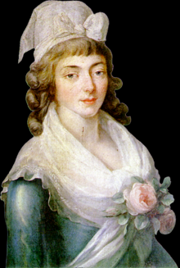
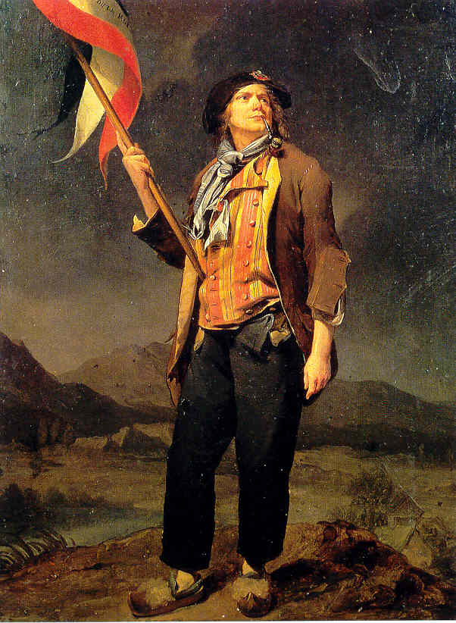
The Mountain and the The Girondins
Two factions of Jacobin clubs, effectively controlled National Assembly
Girondins: transnational network of Enlightenment thinkers rooted in bourgeoisie and eliciting support from peasantry
Mountain: radical Jacobins rooted in sans-culottes and pushing Enlightenment thought to its most egalitarian fringes

Slide 24
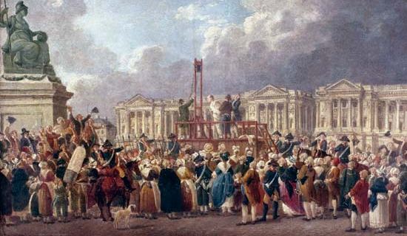
The Terror
Montagnard (Mountain) Jacobin faction gains control
Committee of Public Safety, July 1793
Began executing First and Second Estate, to secure authority
Closes the period of dual power

Slide 25
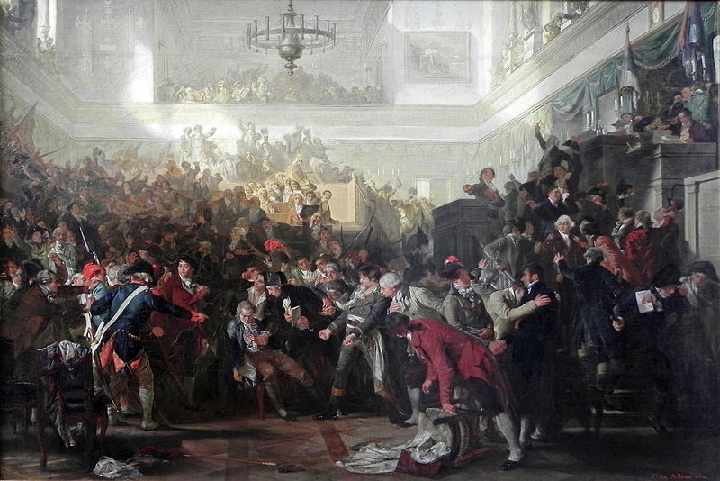
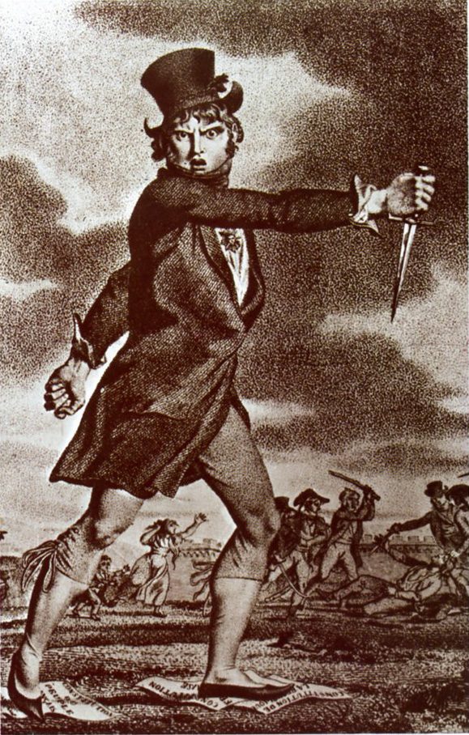
Thermidor and the Directory
Robespierre executed 9 Thermidor Year II (July 27, 1794)
White Terror: wave of violence in reaction to the Great Terror
Directory: five-person executive written into the 1795 Constitution
Directory period (1795-1799) forced to defend revolution against foreign intervention

Slide 26
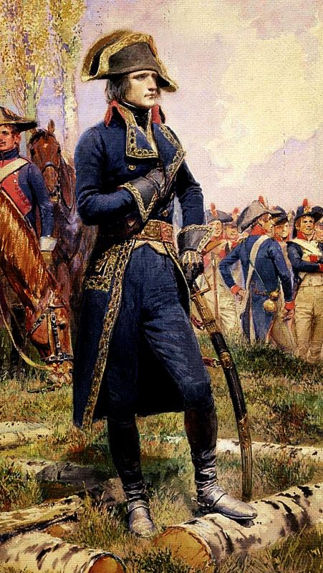
The 18th Brumaire
Napoleon Bonaparte climbed military ranks in wars of Directory period
Girondists suffered military defeats, fueling social instability and threat of royalist restoration
Coup passes to power to military, with Bonaparte as First Consul the Emperor of France

Slide 27
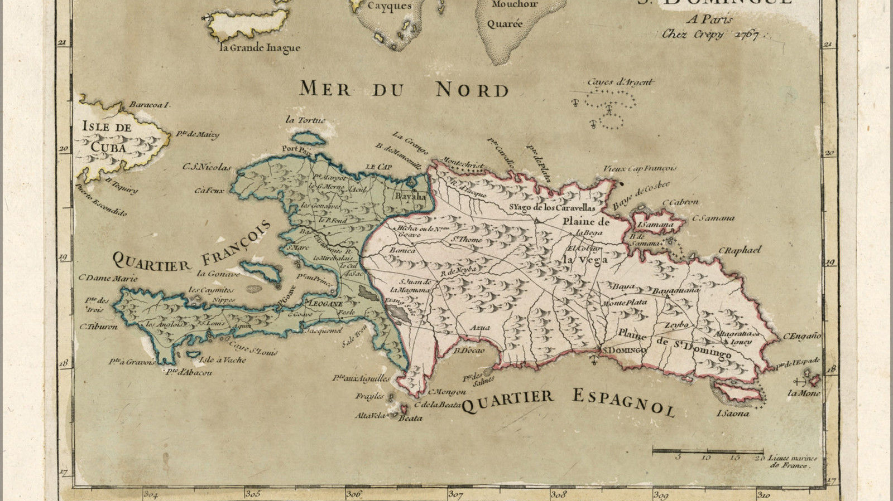
Haitian Revolution
Universalism Reaches its Limits

Slide 28
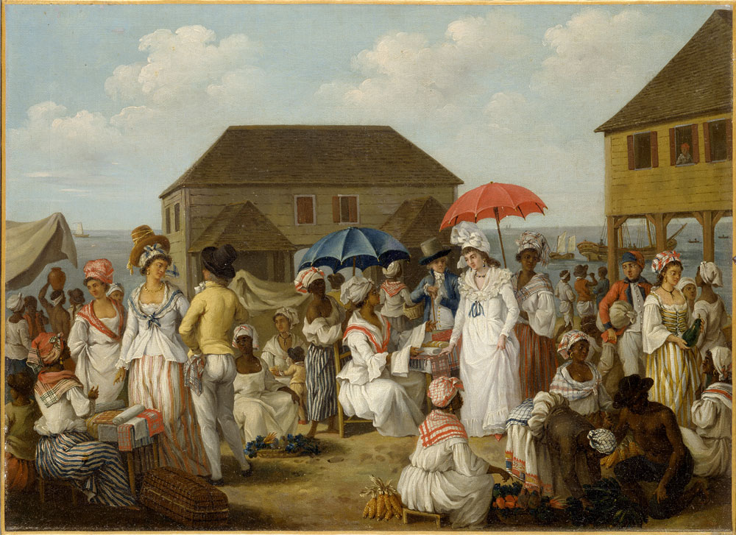
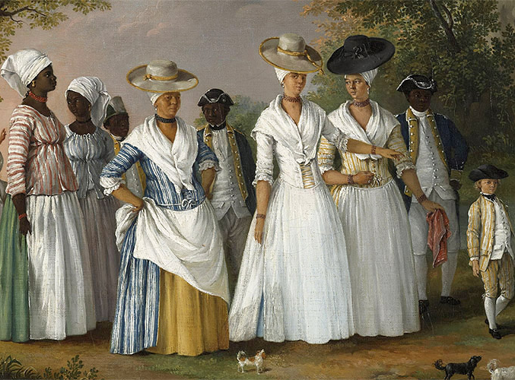
Social Composition of Haiti
Caste system: White planters, white non-planters, free POCs, slaves
40,000 (8%) white French settlers
30,000 (5%) Mulattos and Free Black People
500,000 (87%) black slaves, two thirds first generation Africans
In 1787, French imported 20,000 African slaves to Haiti

Slide 29
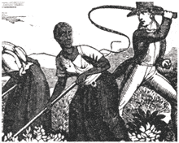
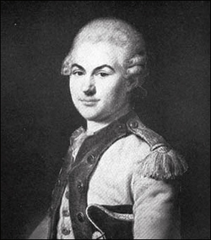
Social Relations of Production
Les grands blancs came from French aristocracy
Miserable work conditions, high death rate
Brutal overseers, even relative to slavery elsewhere
Notes:
Whipping, castration, burning
Rape,
Pictured: vicomte de richambeau, military leader, French aristocrat, plantation owner

Slide 30
Outbreak of the French Revolution
Complex, changing, cross-cutting national and transnational alliances formed and disintegrated over 15-year revolutionary period
White planters initially wanted independence from France
Free people of color wanted racial equality, alternately formed alliances with slaves or with grands blancs
African slaves wanted freedom

Slide 31
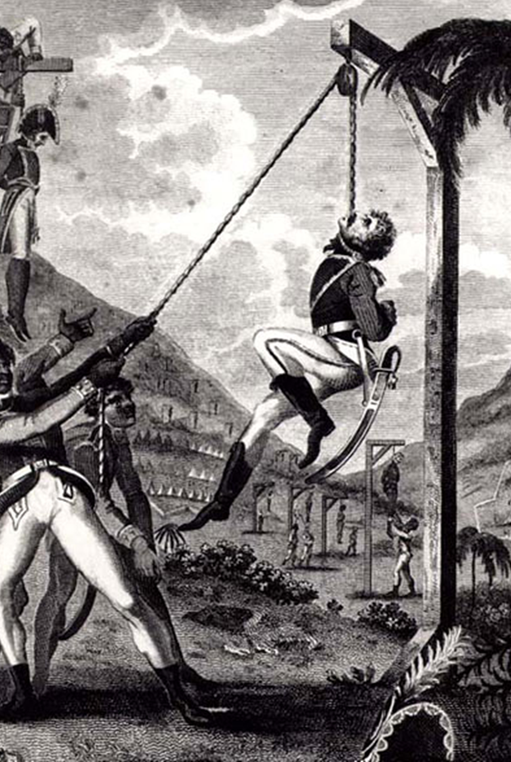
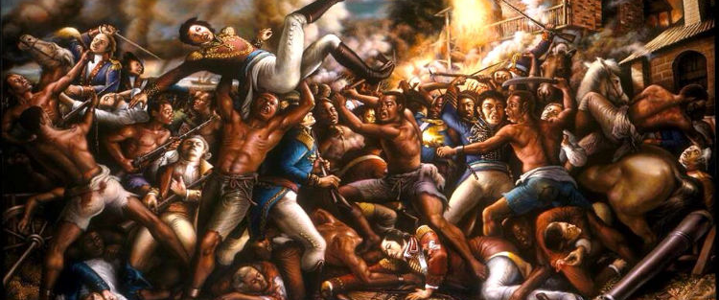
1791: Slave Rebellion

Slide 32
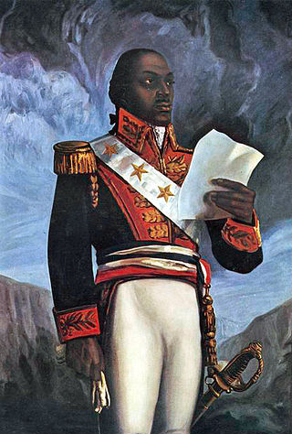
Toussaint Louverture
Influenced by Enlightenment thought
Conscious of its implicit suggestion of black inferiority
Gained effective control and established a constitution declaring Haiti an independent black Republic

Slide 33
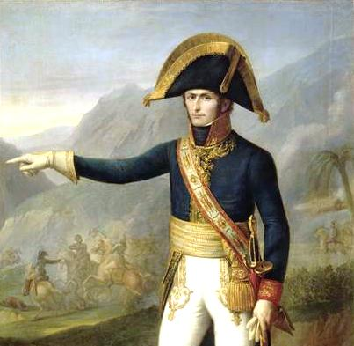
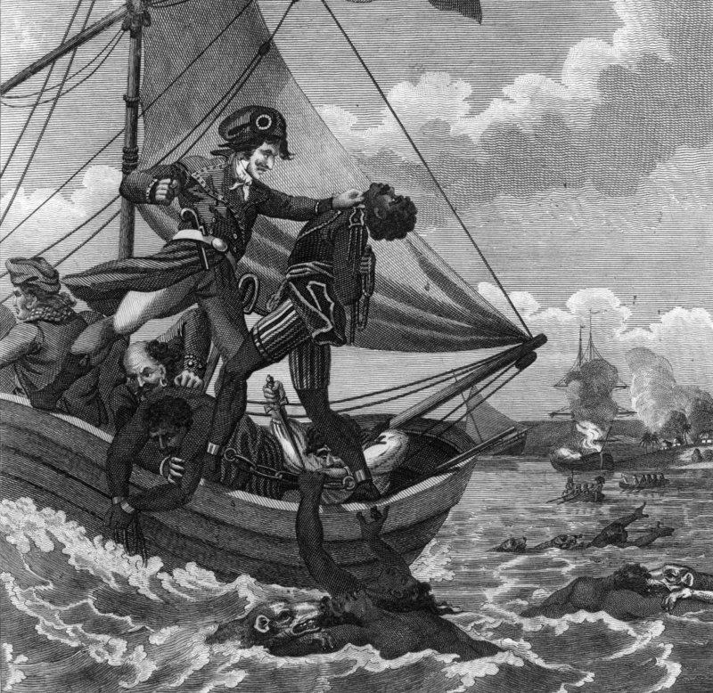
French Reaction and Independence
Napoleon dispatched Charles LeClerc to lead expedition to end Haitian Republic
Imprisoned Toussaint and restored slavery
1802-1804- slaves continued to resist and declared Independent Haitian Republic in 1804

Slide 34
Consequences of Haitian Revolution
The independent Republic of Haiti was weakened by war and underdeveloped by slavery
“Enlightened” Republics isolated Haiti, terrified of igniting local slave revolts
Enlightenment egalitarianism falters over race and social relations of surplus production

Slide 35
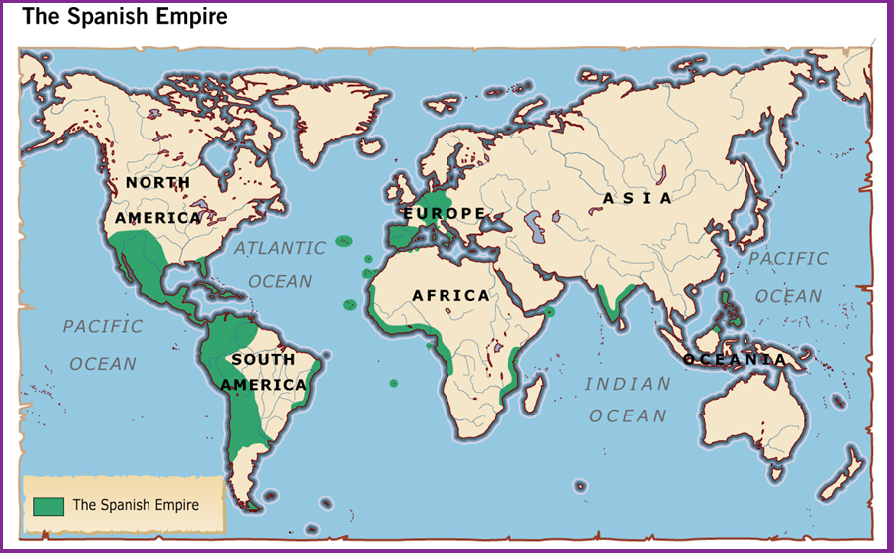
Spanish-American Wars of Independence

Slide 36
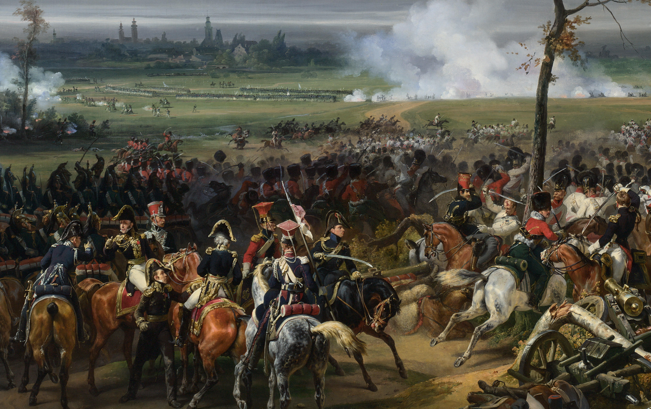
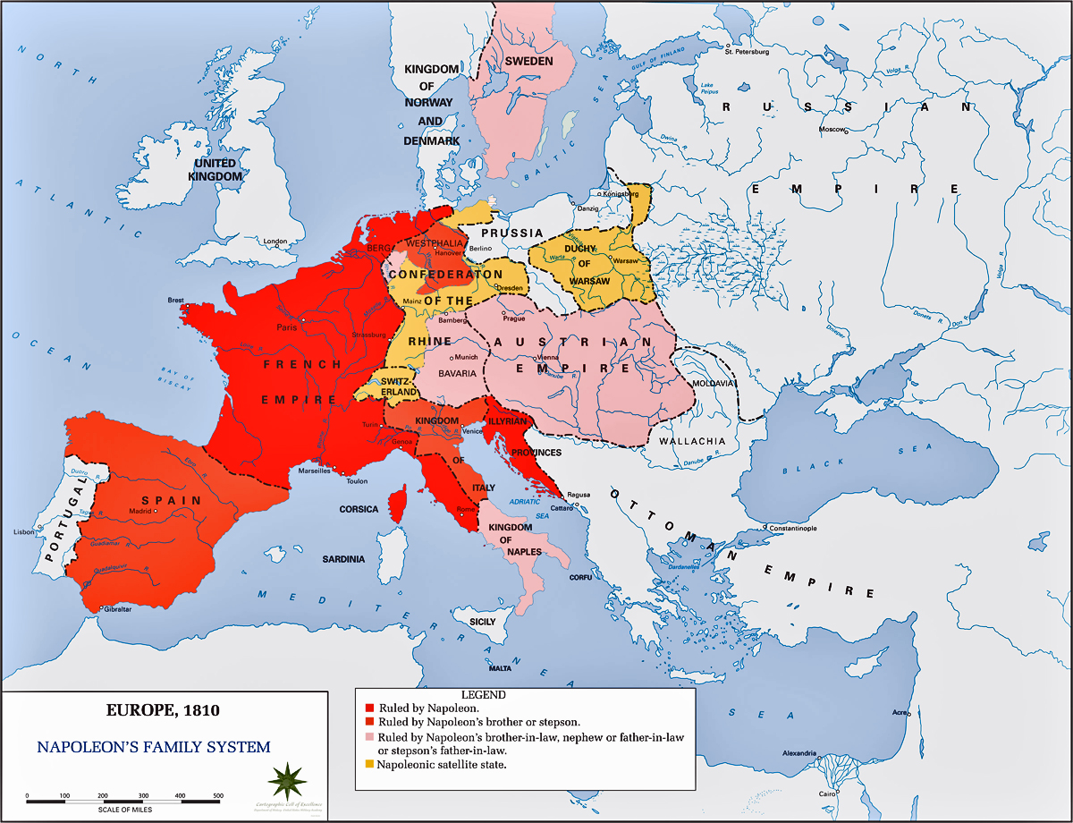
Napoleonic Wars
1799-1805 Napoleon stabilized French Republic and rationalized the bureaucracy
1805-1815 waged series of wars with European powers
Directly or indirectly gained control of most European imperial states

Slide 37
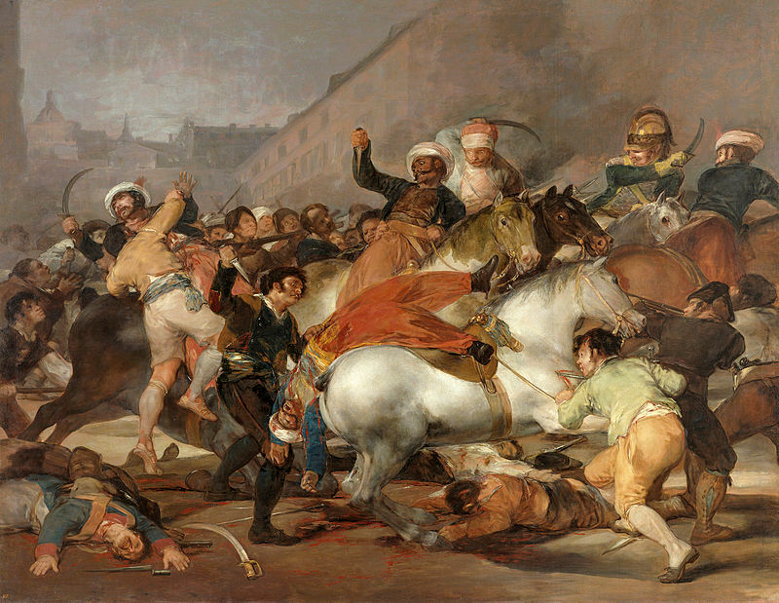
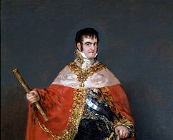
Spain in the Napoleonic Wars
“Peninsular War” began in 1807, Spanish/French war in 1808 when Napoleon betrayed Spanish ally
Ferdinand VII abdicated
Spanish civil authority collapsed in Dos de Mayo uprising (depicted corner left)
Country fragmented into regional juntas, setting off period of instability that reverberated throughout the Spanish Empire

Slide 38

Spanish Americans Assert their Sovereignty
Revolts in Chuquisaca (Bolivia) and Quito (Ecuador) signal Primer Grito Libertario against colonial rule
After 1810, Spanish Americans claim sovereignty through “Open Cabildos”

Slide 39



Pan Spanish Americanism
Formation of independent Spanish American (Creole) nationalism
Simón Bolívar established Gran Colombia (Northern South America, modern Venezuela, Bolivia, Colombia, Panama, and Peru)
José de San Martín served cause of United Provinces of R$í$o de la Plata (Southern Cone, modern Chile, Argentina and Peru)
1820-1830- Latin American federalism gives way to independent nation-states

